Slide 1

The Principles of Object-Oriented JavaScript
A brief summary prepared by: Manahill Ali

Slide 2
5
Inheritance
You may simply write code and create data structures as needed with JavaScript.

Slide 3
TABLE OF CONTENTS
01
02
03
04
Prototype chaining and object . prototype
Object Inheritance
Constructor Stealing
Constructor Inheritance
Accessing Supertype Methods
05

Slide 4
Introduction
In JavaScript, inheritance is supported by using prototype object.
Some people call it "Prototypal Inheritance" and some people call it "Behavior Delegation.
Let's see how we can achieve inheritance like functionality in JavaScript using prototype object.
Notes:
اهنى قبل ما نقول الأنواع بنقول شن معنى تايب أصلا تايب معناها نوع البيانات اللي في المشروع متعي أبسط مثال هي الأنواع intger , double, string…etc.

Slide 5
—Nicholas C. Zakas
“In JavaScript, however, Inheritance can occur between objects with no classlike structure defining the relationship.
The mechanism for this inheritance is one with which you are already familiar: prototypes.”

Slide 6
Prototype chaining and object.prototype
When it comes to inheritance, JavaScript only has one construct: objects. Each object has a private property which holds a link to another object called its prototype. That prototype object has a prototype of its own, and so on until an object is reached with null as its prototype. By definition, null has no prototype, and acts as the final link in this
prototype chain.
JavaScript uses a similar concept for creating an inheritance by chaining multiple instances to prototypes and creating nested prototypes.

Slide 7
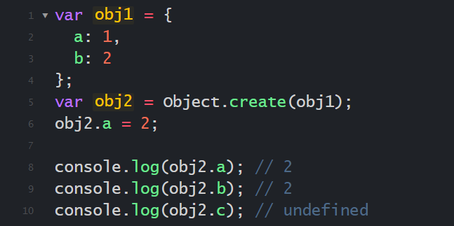
Prototype chaining
Let me make it more clear for you by an example:

Slide 8
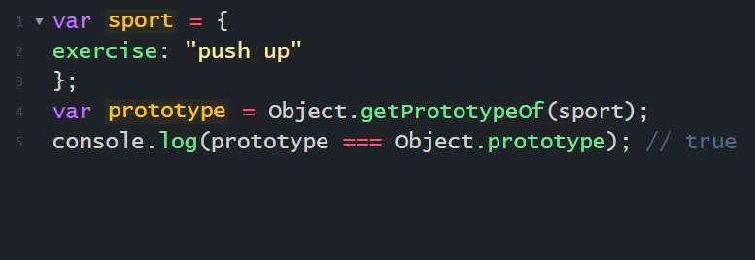
object . prototype
Object.prototype, defined via an object literal has its Prototype set to
Object.prototype , meaning that it inherits properties from Object.prototype.
Object.getPrototypeOf() method returns the prototype.
This’s default behavior, that sport has equal prototype to Object.prototype.

Slide 9
Methods Inherited from Object.prototype
Lots of methods used in this chapter till now are defined on Object.prototype and are therefore inherited by all other Objects, methods like:
hasOwnProperty(): Determines whether an own property with the given name exists.
propertyIsEnumerable(): Determines whether an own property is enumerable.
isPrototypeOf(): Determines whether the object is the prototype of another.
valueOf(): Returns the value representation of the object.
toString(): Returns a string representation of the object.

Slide 10
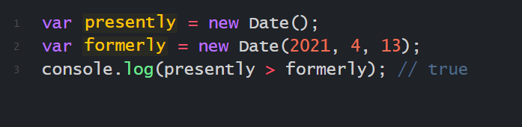
Methods Inherited from Object.prototype
valueOf()
method returns the primitive value of the specified object,
The valueOf() method gets called whenever an operator is used on an object.
Before the comparison, the method is called on both objects.
You can even subtract one date from another and get the difference in epoch time because of value().

Slide 11
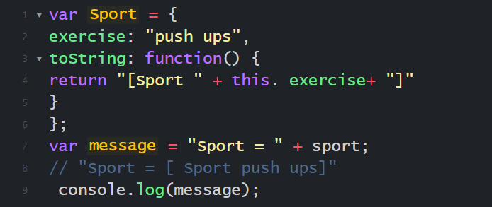
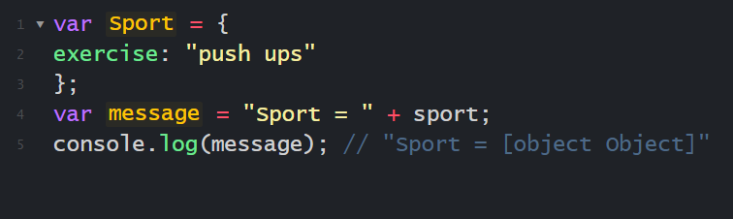
Methods Inherited from Object.prototype
toString()
method returns a string representing the object, The toString() method is called as a fallback whenever valueOf() returns a reference value instead of a primitive value.
`
This code defines a custom toString() method for Sport that returns a more useful value u than the inherited version.
combining “Sport= " with sport.

Slide 12
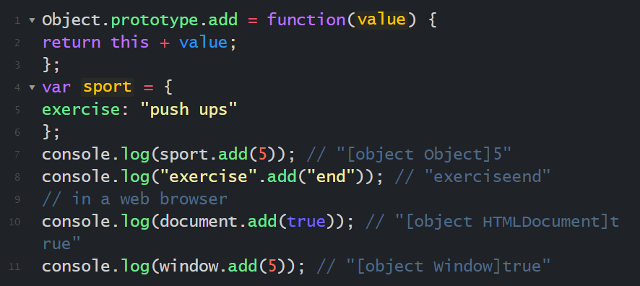
Methods Inherited from Object.prototype
Modifying Object.prototype
all objects inherit from Object.prototype by default, so changes to Object.prototype affect all objects.
`
Adding Object.prototype.add() causes all objects to have an add() method

Slide 13
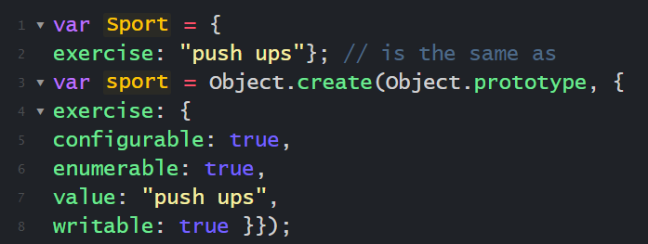
Object Inheritance
Object literals have Object.prototype set as their Prototype implicitly, but you can also explicitly specify Prototype with the Object.create() method.
`
second declaration takes the same steps but does so explicitly
using
The Object.create() method creates a new object, using an existing object as the prototype of the newly created object.
-second declaration takes the same steps but does so explicitly
Using Object.create().

Slide 14
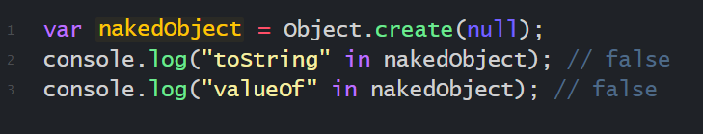
Object Inheritance
also You can create objects with a null Prototype via Object.create(),
Like this:
`
The nakedObject in this example is an object with no prototype chain.
That means built-in methods such as toString() and valueOf() aren’t present on the object..

Slide 15
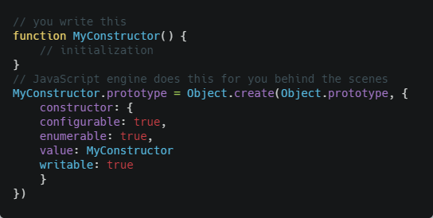
Constructor Inheritance
In JavaScript, constructor inheritance is based on object inheritance.
the JavaScript engine does the following for you:
without doing anything extra, this code sets the constructor’s prototype property to an object that inherits from Object.prototype, which means any instances of MyConstructor also inherit from Object.prototype.

Slide 16
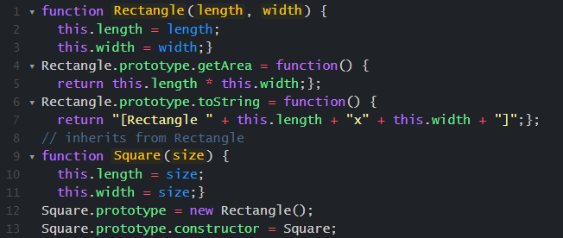
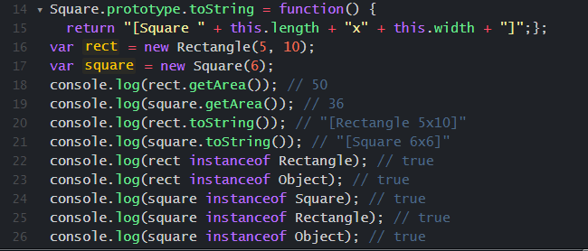
Constructor Inheritance
There are two constructors, In this code :
The Square constructor has its prototype property overwritten with an instance of Rectangle. No arguments are passed into Rectangle at this point because they don’t need to be used, After that, rect is created as an instance of Rectangle, and square is created as an instance of Square. Both objects have the getArea() method because it is inherited from Rectangle.prototype. The square variable is considered an instance of Square as well as Rectangle and Object because instanceof uses the prototype chain to determine the object type.
`

Slide 17
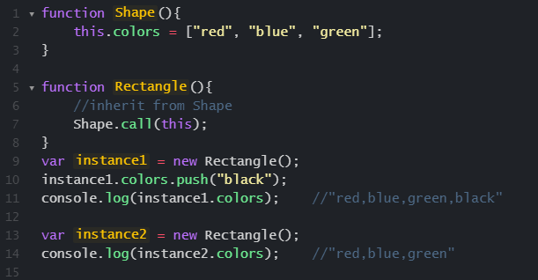
Constructor Stealing
Constructor Stealing is to call the Shape constructor from within the Rectangle constructor.
The apply() and call() methods can be used to execute a constructor on the newly created object
In effect, you’re stealing the supertype constructor for your own object.

Slide 18
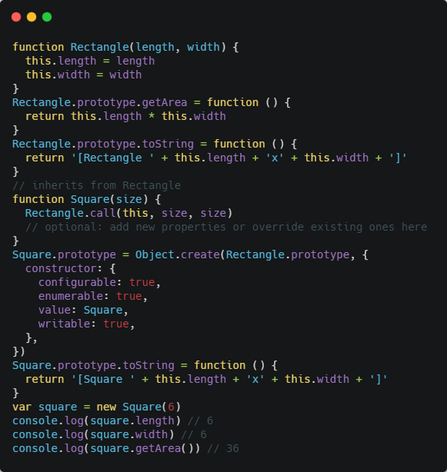
Constructor Stealing
Square constructor calls the Rectangle constructor and passes in this as size two times.
so creates the length and width
properties on the new object and makes each equal to size.
So you can add new properties or override existing ones after applying the type constructor.

Slide 19
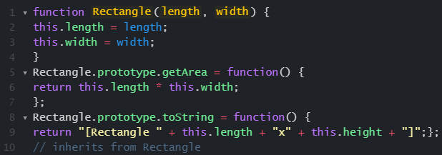
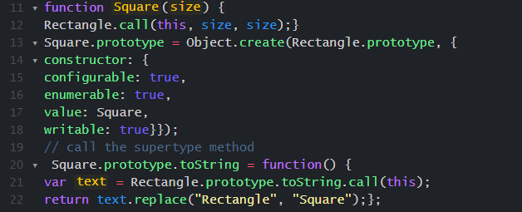
Accessing Supertype Methods
We an directly access the method on the supertype’s
prototype and use either call() or apply() to execute the method on the
subtype object.
For example:
this code, u Square.prototype.toString() calls
Rectangle.prototype.toString() by using call(). The method just needs
to replace "Rectangle" with "Square" before returning the resulting text.
This approach may seem a bit verbose for such a simple operation, but
it is the only way to access a supertype’s method.

Slide 20
The End Any Question?

